Slide 1
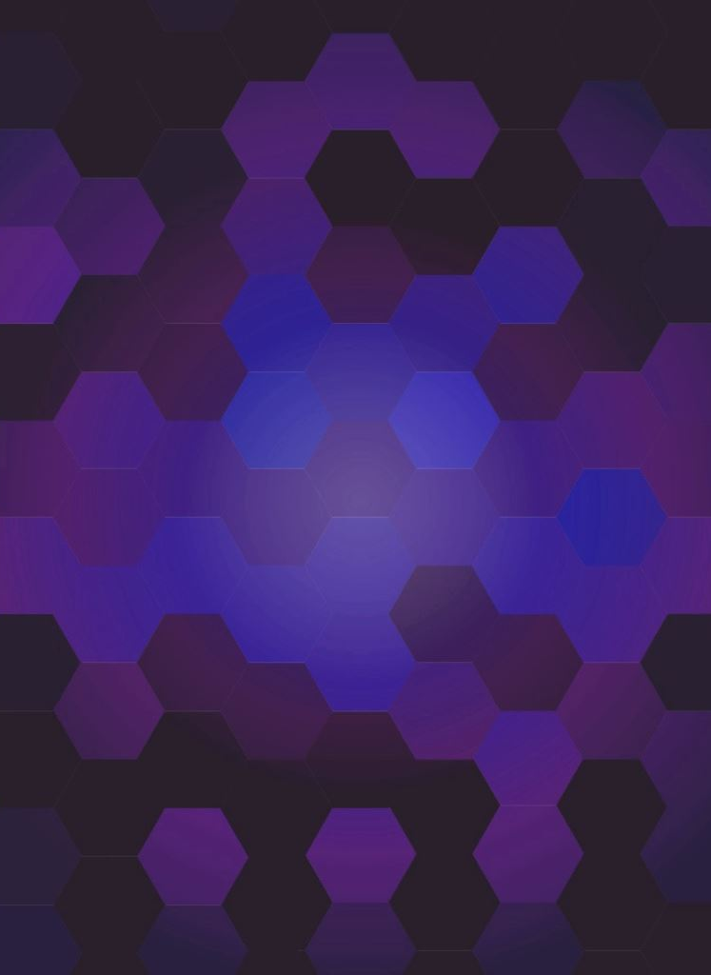
CSC492H5 Web Design: Wireframes to Prototypes
Notes:
Course 4: Web Design: Wireframes to Prototypes
This course dealt more with knowledge as opposed to deliverables (beyond revisiting previous work)
I’ll hold off on my comments until the end.
Questions from Petersen:
When creating profiles, REALLY think about making them different. Think about accessibility, think about genders, think about different usecases.

Slide 2
Week 1: The Wireframe Phase
Topics covered:
Low Fidelity Mockups
Common Design Patterns
Homepage Content Strategy
Navigation Systems
Wireframing Tools
Notes:
Week 1 was about the wireframe phase. This was mostly revisiting what we did in Course 2 with some added material.
We discussed Low fidelity mockups which simplified and low detail prototypes that are mainly concerned with what goes where. They can be thought of as skeletons and visual design mock-ups are the skin.
We discussed a ton of Navigation Systems including Primary, Secondary, Utility, Related Content, Inline Links, etc etc. These are sets of navigations that are grouped together based on significance or purpose.
Common Design Patterns, but not like the ones we learn in CSC207. In UX design, this refers to headers, footers, sidebars, among others. These are the structures that content is commonly formatted in.
We talked about what should be on the homepage. We should be able to answer: What is this? What can I do here? Where do I start?
Lastly, we went over some Wireframing tools. Out of the ones that were mentioned in the course, Balsamiq was one tool that seems great to quickly mock-up some B&W clickable wireframes. I personally have been using Figma from previous projects and found that Balsamiq is better for creating lower-fidelity wireframes and I’ll likely use it for my next project.

Slide 3
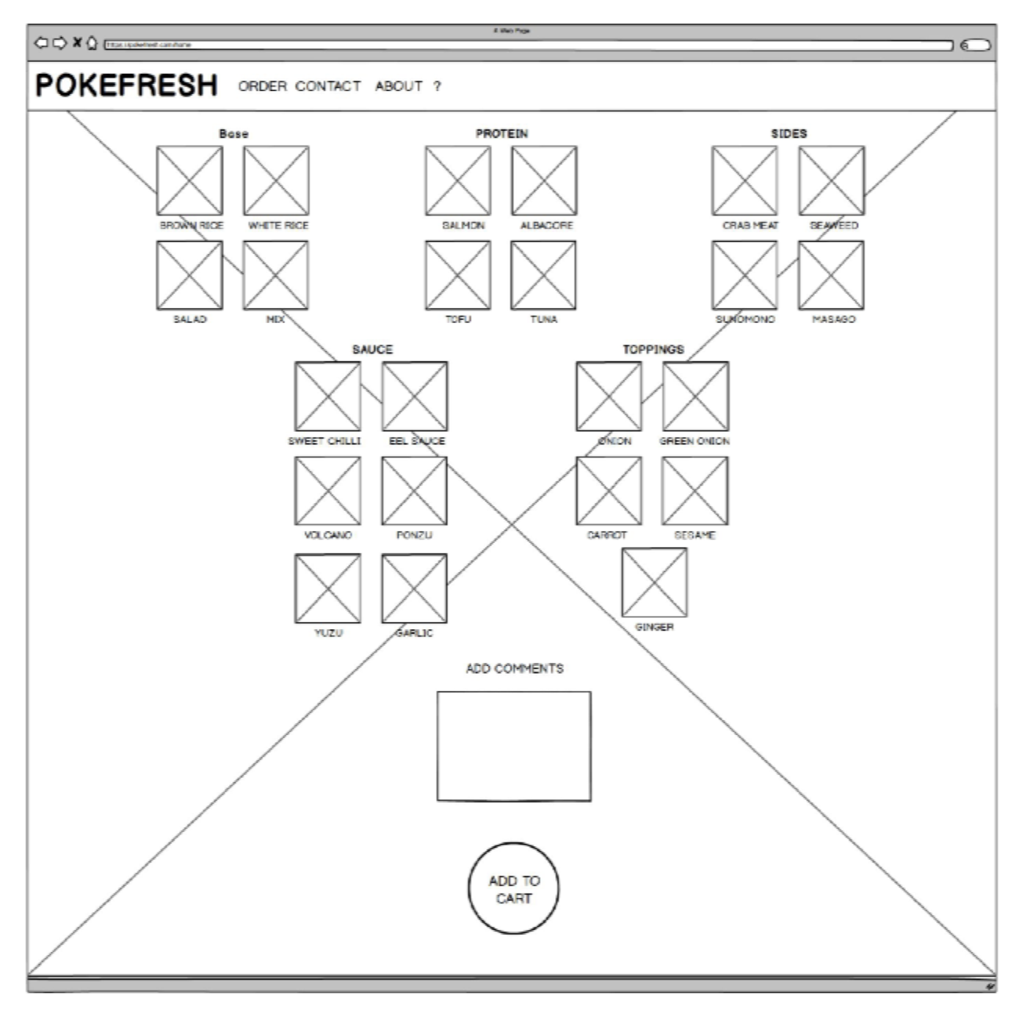
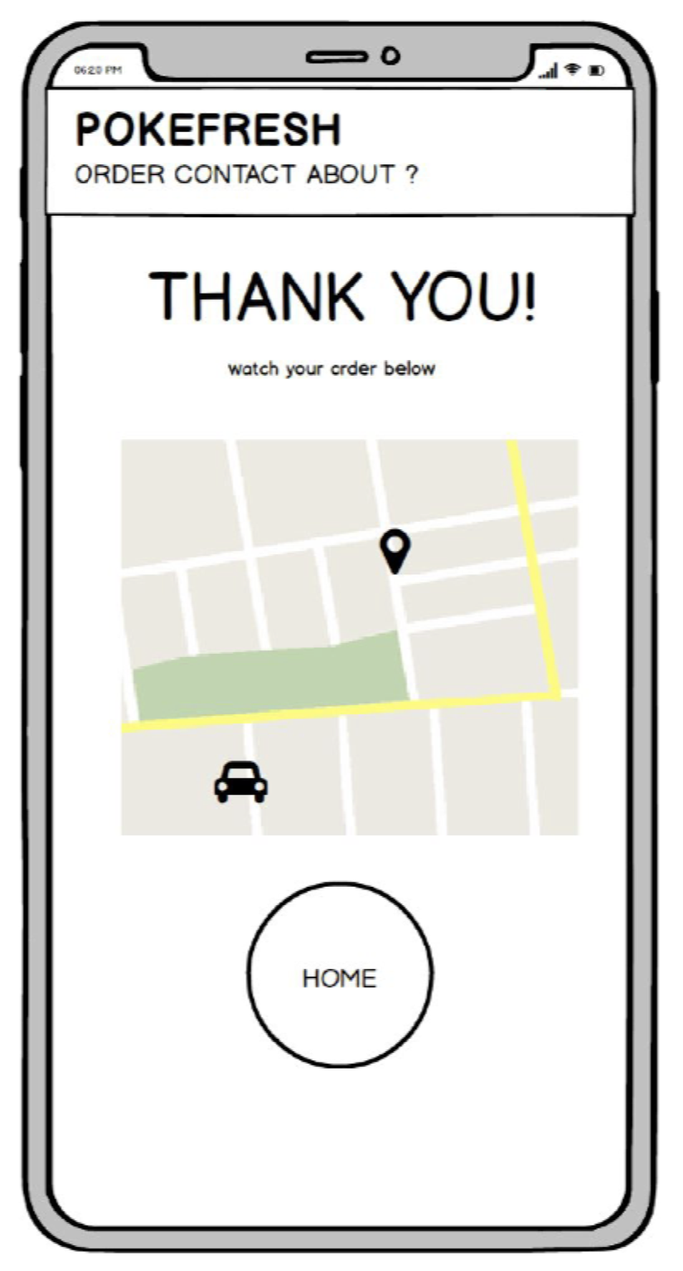
Notes:
Out of the ones that were mentioned in the course, Balsamiq was a tool that seemed great to quickly mock-up some B&W clickable wireframes. I personally have been using Adobe Illustrator since I already had the subscription but after playing around with Balsamiq, it seems a lot better for creating lower-fidelity wireframes. So, it will probably be my go-to tool for my next project.

Slide 4
Notes:
Here were the low-fi mockups I made for Nox. These were actually made while working on Course 2. I also merged the flow of the pages as well just so the interactions were a little more clear.

Slide 5
Week 2: Visual Mock-ups
Topics covered:
Look and Feel
Design Principles and Whitespaces
Web Typography
Scale, Weight, Direction, Form, Texture, Space, Value, Colour.
Font, Horizontal Spacing, Vertical Spacing, Colour choices.
Notes:
This week was on Visual Mockups and was focused on the final look and feel of the product.
We discussed Design Principles and the importance of whitespace.
From there we discussed Web Typography where we learned about some resources available to us and best practices for Font, Horizontal and Vertical Spacing, and Colour choices.
If you have a blog site for example, or any site that is text heavy, don’t use pure whites and pure blacks, it creates too much strain on the eyes. Use more mellow shades of white and black preferably with slightly blue hues.

Slide 6
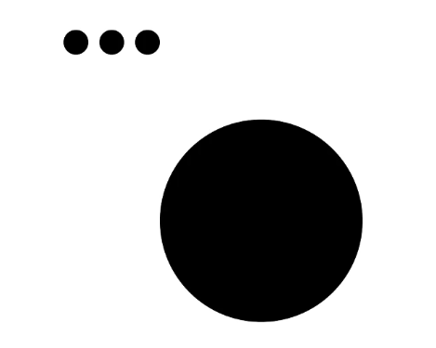
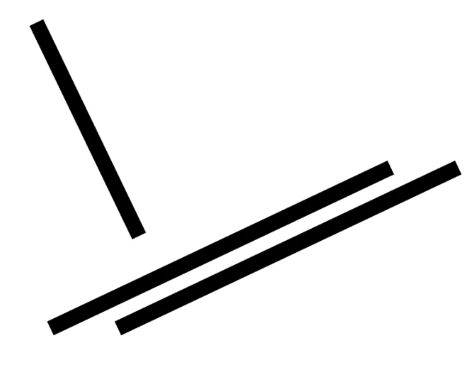
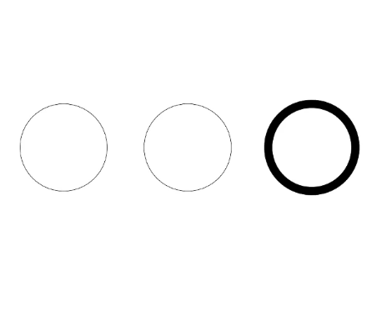
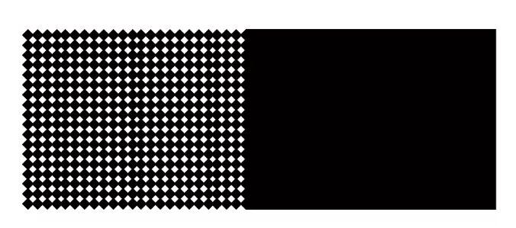
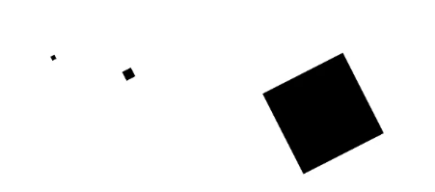



Notes:
We discussed the importance of creating a VISUAL HIERARCHY by using contrasts which can be done by creating differences in:
Scale – Bigger sizes stand out
Weight – Bolded objects stand out
Direction – If you have all parallel lines and 1 perpendicular line, that 1 will stand out.
Form – Angular vs round shapes
And Texture, Space, Value, Colour.
About the white spaces, long story short, in print and the early days of the internet, space was precious. But now with our fast internet speeds, space can be used more liberally and as a form of creative expression.

Slide 7
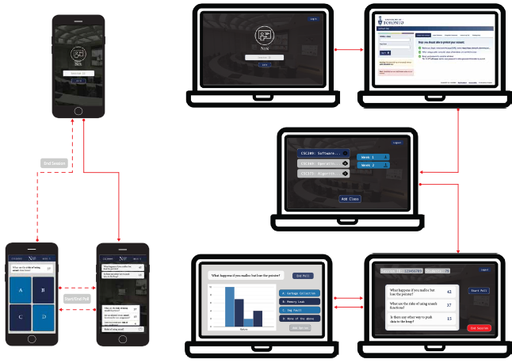
Notes:
Here is the visual mock-up I made for Nox. This basically just added the skin onto the skeleton which was the low-fidelity mock-up. These were from course 2 but checked against the material discussed this week.

Slide 8
Week 3: Welcome to Codelandia
Topics covered:
Web Technologies
Client-Side Coding
Server-Side Coding
Notes:
Onto week 3. This week was a broad overview of the technologies that go into actually developing a website. This was taught for complete beginners to coding. Though, I found it helpful as a refresher and learned some things about the web inspector tool.

Slide 9
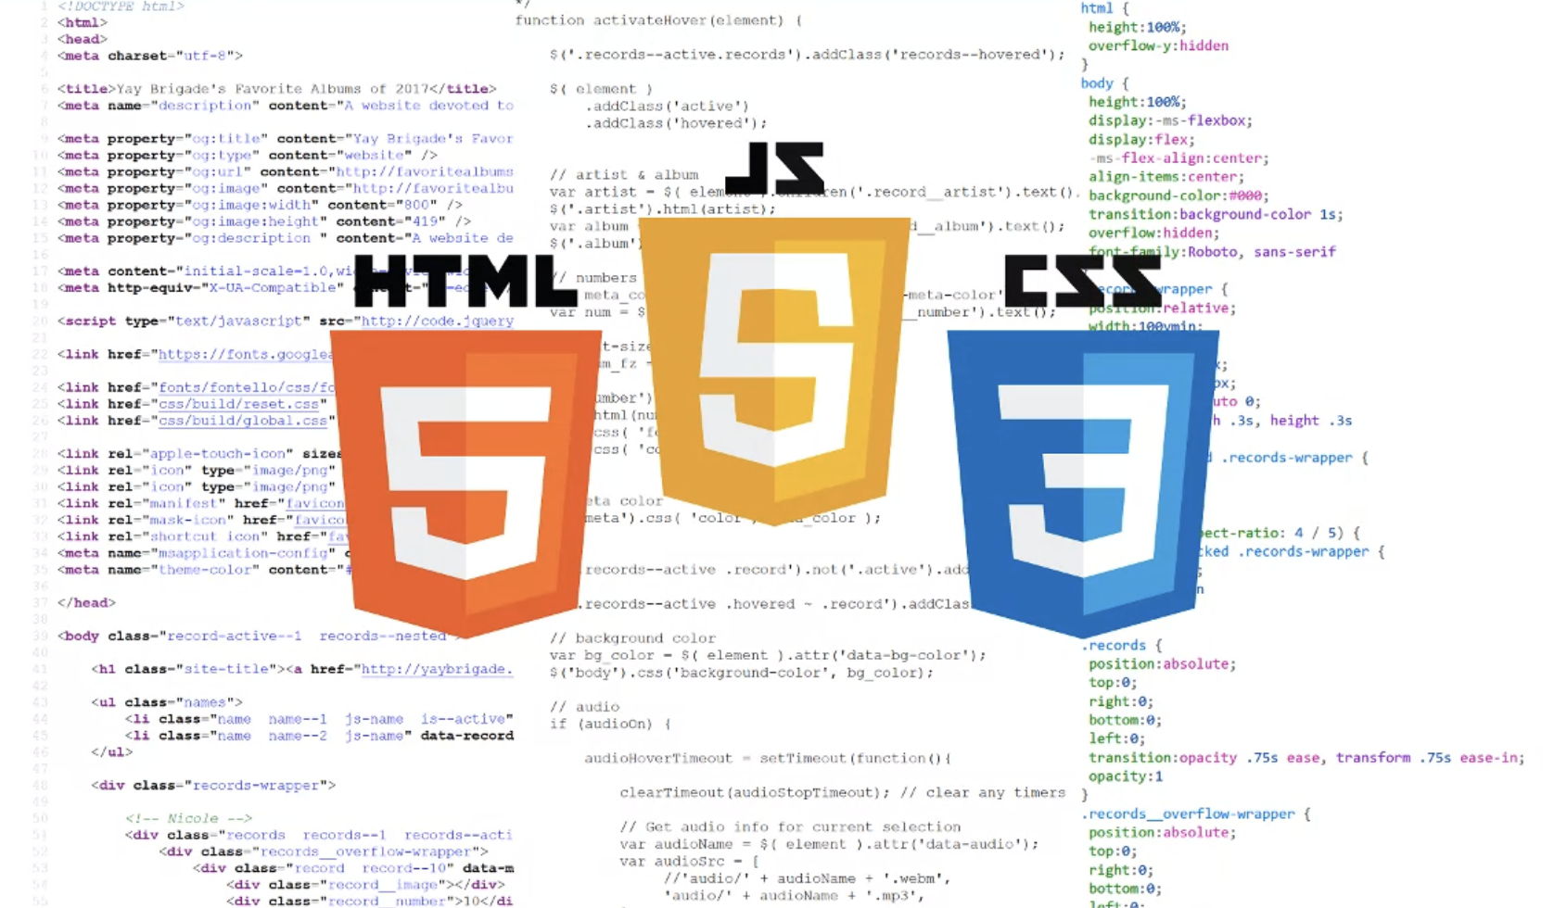
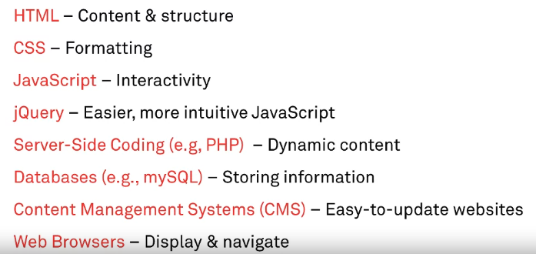
Notes:
We focused more on the Client-Side and discussed HTML + CSS + Javascript and what each of their roles is. We also spoke about jQuery which introduced the notion of libraries that can be used to simplify some functionality over vanilla code.
For the Server Side coding languages, Databases, Content Management Systems, Web Browsers, and how they all interact with one another.
We didn’t speak at all about any cloud services, but that was sort of expected. This was more just an information session, there was no new deliverable from the previous week.

Slide 10
Week 4: Making a Clickable Prototype
Topics covered:
Tools to Make Clickable Prototypes
Deceptive Design Patterns
Dark Patterns
InVision
Notes:
This week was about Making Clickable Protoypes, but also about Dark patterns which was pretty cool topic.
Nothing new here, we created clickable prototypes in Course 2 but with a focus on using InVision which was very similar to the tool I used called Figma. But we went over general ideas such as exporting assets and creating hotspots to make your prototypes feel as close to a finished product as possible. Again, the goal of it is to give the illusion of a fully developed product.

Slide 11
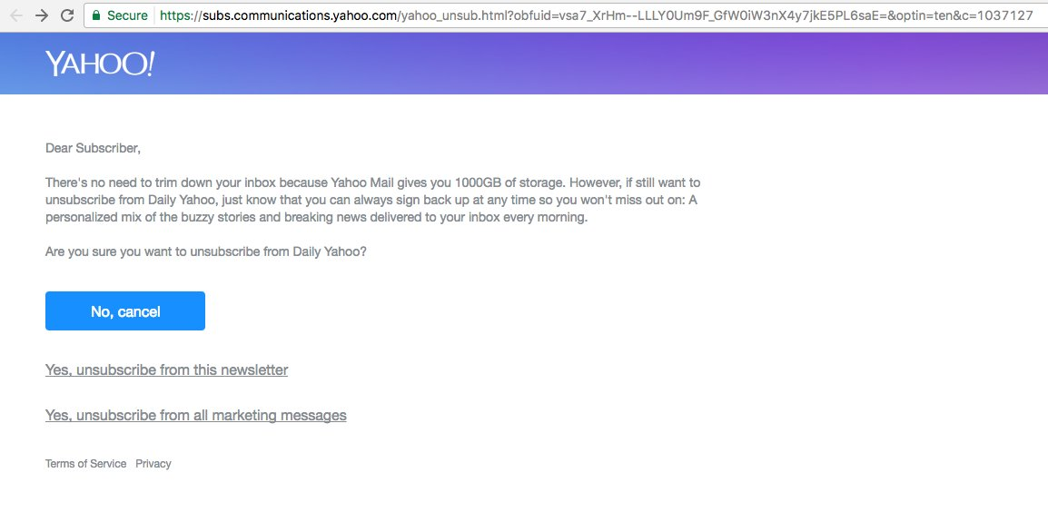
Notes:
But learning about Dark Patterns was pretty cool. They’re also known as deceptive design patterns, and essentially are features of interface design crafted to trick users into doing things they might not want to but that benefit the business. Like buying a specific product or signing up for something. Amazon is NOTORIOUS for this. If you want to delete your Amazon account for example, they hid the option so deep in their navigation that you probably wouldn’t be able to figure it out unless you googled it.
Unsubscribe buttons on emails are also an example. This isn’t even as bad as some I’ve seen.

Slide 12
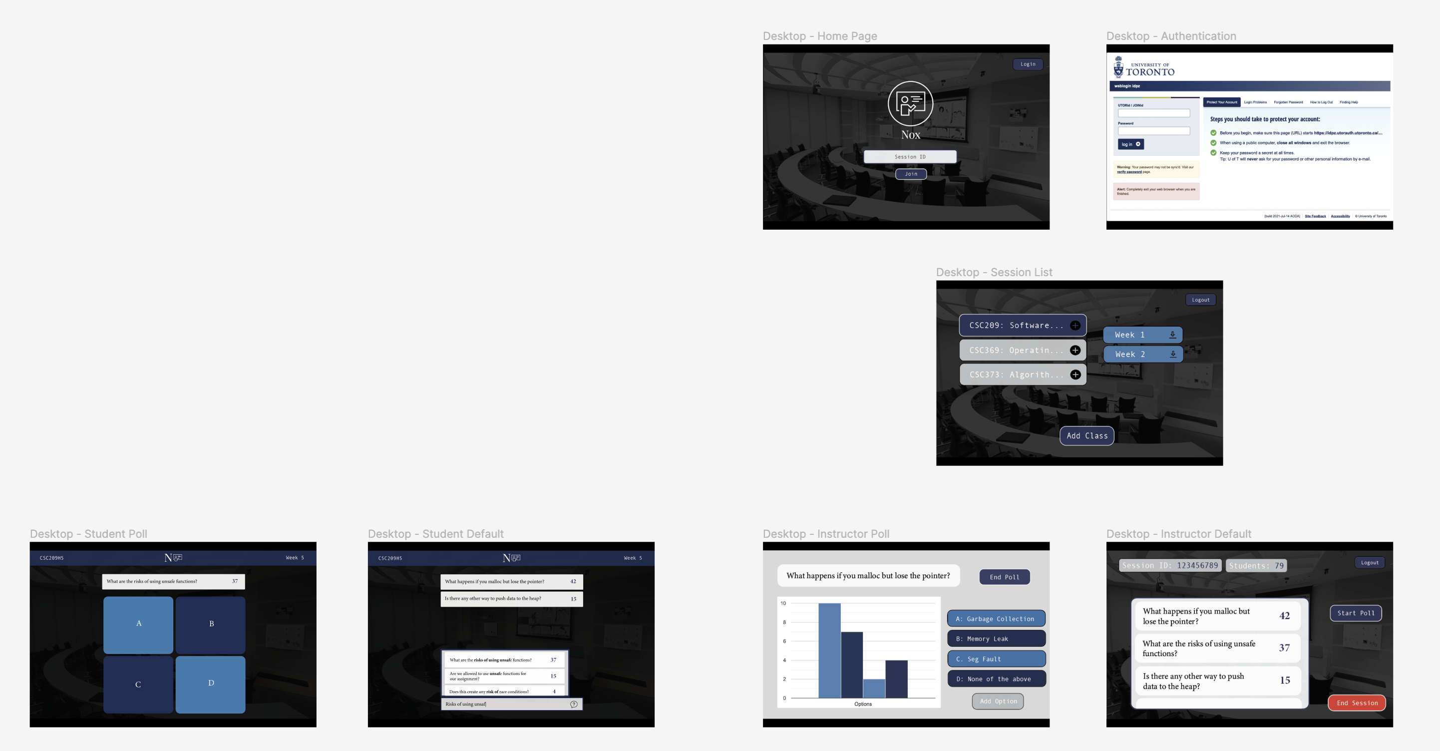
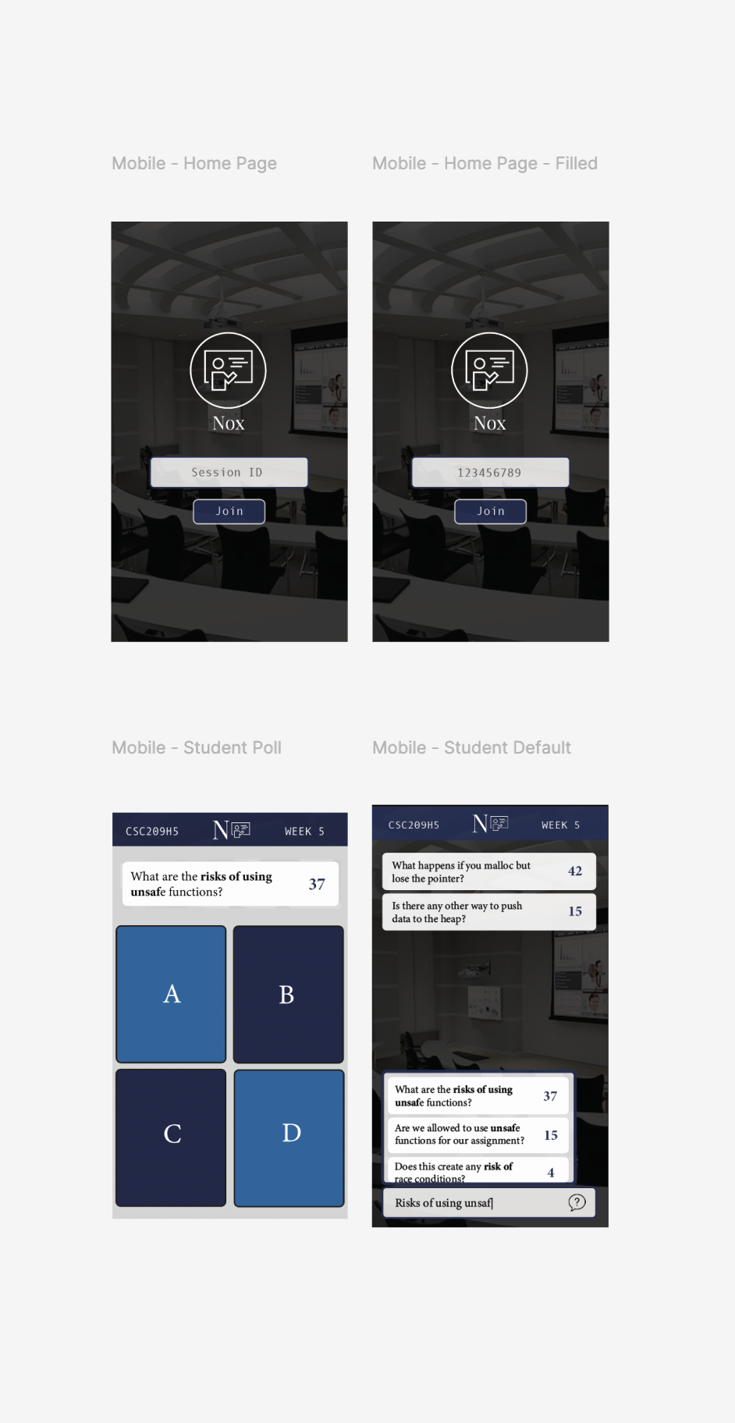
Notes:
These are images from the clickable prototype I made on Figma. I presented them during last presentation so for the sake of time, I’ll skip over the demo for now.
Desktop: https://www.figma.com/proto/46ADauiwYJoKSDppoMhsez/Nox-Second-Prototype?node-id=153%3A42&starting-point-node-id=153%3A42
Mobile: https://www.figma.com/proto/46ADauiwYJoKSDppoMhsez/Nox-Second-Prototype?node-id=2%3A22&starting-point-node-id=2%3A22

Slide 13
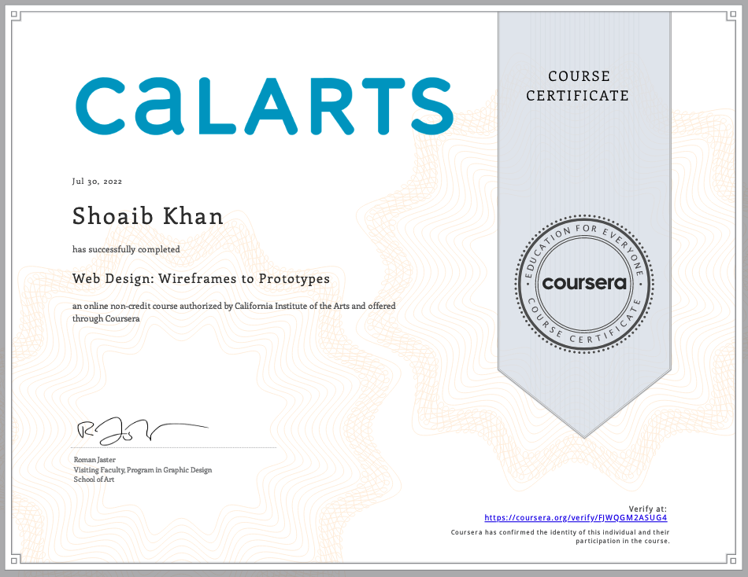
Notes:
And that wraps up this course.
This course was lighter than the previous courses in terms of content, but I think a large component of that was because of the entire section about the development process of a website and the fact that I had a background in that to begin with. This course, like the third one was quite redundant. I think the second course was just really well put together. It covered a ton of ground that courses 3 and 4 just added on to.
I felt there was too much overlap and the new material that was covered wasn’t all that new or exciting.

